Slide 1

Testing

Slide 2
Just One More Thing
STOP: Would you bet your life against $1 million that the functions that we have written are correct?

Slide 3
Just One More Thing
STOP: Would you bet your life against $1 million that the functions that we have written are correct?
All code, before being published, should be tested. In unit testing, we test individual functions independently of each other.

Slide 4
Just One More Thing
STOP: Would you bet your life against $1 million that the functions that we wrote are correct?
All code, before being published, should be tested. In unit testing, we test individual functions independently of each other.
Key point: This is another benefit of having modular code, since the more functions we have, the easier it will be to isolate any problems.

Slide 5
FIRST Principles for Unit Testing
For each function, tests should be:
Fast (don’t have gigantic, slow test datasets)

Slide 6
FIRST Principles for Unit Testing
For each function, tests should be:
Fast (don’t have gigantic, slow test datasets)
Independent (we should test one type of outcome at a time)

Slide 7
FIRST Principles for Unit Testing
For each function, tests should be:
Fast (don’t have gigantic, slow test datasets)
Independent (we should test one type of outcome at a time)
Repeatable (if we run tests multiple times, or on different machines, we should get same outcome)

Slide 8
FIRST Principles for Unit Testing
For each function, tests should be:
Fast (don’t have gigantic, slow test datasets)
Independent (we should test one type of outcome at a time)
Repeatable (if we run tests multiple times, or on different machines, we should get same outcome)
Self-validating (the tests we run should not require additional downstream testing)

Slide 9
FIRST Principles for Unit Testing
For each function, tests should be:
Fast (don’t have gigantic, slow test datasets)
Independent (we should test one type of outcome at a time)
Repeatable (if we run tests multiple times, or on different machines, we should get same outcome)
Self-validating (the tests we run should not require additional downstream testing)
Thorough (in our tests, we should try to capture as many bugs as possible)

Slide 10
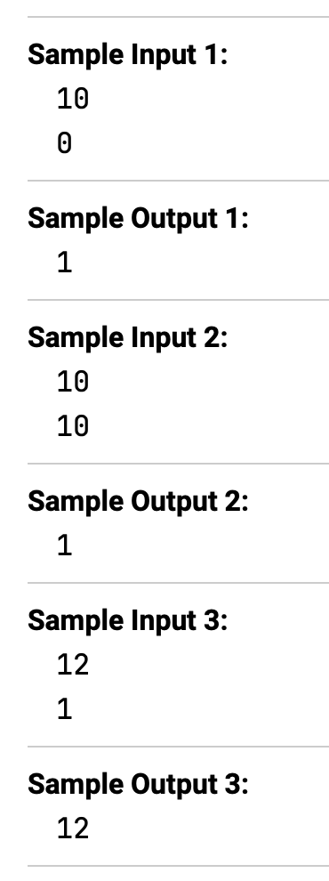
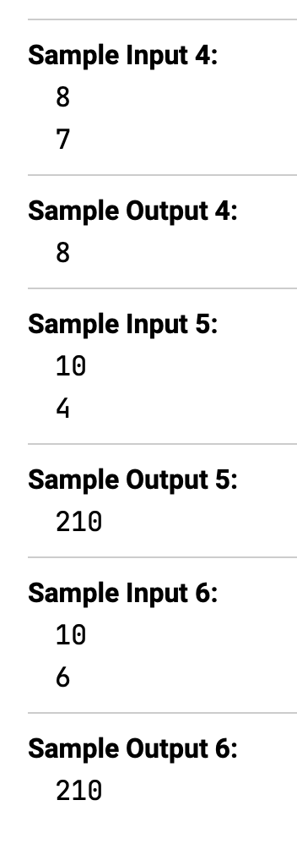
We’ve seen testing since we started!
Combination Statistic Problem:
Input: Integers n and k.
Output: The combination statistic C(n, k).
STOP: What are each of these test datasets trying to test for?

Slide 11
We’ve seen testing since we started!
Combination Statistic Problem:
Input: Integers n and k.
Output: The combination statistic C(n, k).
Edge case: a set of inputs that require special care or that are at extreme parameter values.
STOP: Which test cases do you think are edge cases?

Slide 12
We’ve seen testing since we started!
Combination Statistic Problem:
Input: Integers n and k.
Output: The combination statistic C(n, k).
Edge case: a set of inputs that require special care or that are at extreme parameter values.
STOP: Which test cases do you think are edge cases?

Slide 13
We write a function to test a function
def test_combination_all():
# Each tuple is (n, k, expected)
cases = [
(10, 0, 1),
(10, 10, 1),
(12, 1, 12),
(8, 7, 8),
(10, 4, 210),
(10, 6, 210),
]
i = 0
while i < len(cases):
n, k, expected = cases[i]
actual = combination(n, k)
assert actual == expected, f"case {i} failed: C({n},{k})={actual}, expected {expected}"
i = i + 1

Slide 14
Let’s see how Python implements this!
Python provides a lot of support with the pytest package. To install it, run pip install pytest (Windows) or pip3 install pytest (macOS).
We provide some starter code with combination() and test_combination_all(). You can run tests using python -m pytest main.py (Windows) or python3 -m pytest main.py (macOS).

Slide 15
Let’s see how Python implements this!
def combination(n: int, k: int) -> int:
"""Return C(n, k) with basic input validation.""”
# skipping parameter checks
if k == 0 or k == n:
return 420 # this will fail the edge cases
if k == 1:
return n
result = 1
i = 1
while i <= k:
result = (result * (n - k + i)) // i
i = i + 1
return result
Our code is correct, so let’s change it a bit so that it is wrong and run the tests again!

Slide 16
Suggestion for organizing test datasets
project
│ main.py
│ (other Python files)
│
└───tests
│
└───combination
│
│───input
│ input_0.txt
│ input_1.txt
│ ...
│
│───output
output_0.txt
output_1.txt
...
function name
input and output for the same test dataset

Slide 17
Let’s practice!
Bray-Curtis Distance Problem:
Input: Two frequency maps freq1 and freq2 corresponding to two samples.
Output: The Bray-Curtis distance between the two samples.
Jaccard Distance Problem:
Input: Two frequency maps freq1 and freq2 corresponding to two samples.
Output: The Jaccard distance between the two samples.
Exercise: Design test cases for these two problems.

Slide 18
We may plan top down, but we should test (and debug) bottom up
f1()
f2()
f3()
f4()
f5()
f6()
f7()
f8()
f9()

Slide 19
We may plan top down, but we should test (and debug) bottom up
f1()
f2()
f3()
f4()
f5()
f6()
f7()
f8()
f9()

Slide 20
We may plan top down, but we should test (and debug) bottom up
f1()
f2()
f3()
f4()
f5()
f6()
f7()
f8()
f9()

Slide 21
We may plan top down, but we should test (and debug) bottom up
f1()
f2()
f3()
f4()
f5()
f6()
f7()
f8()
f9()

Slide 22
Unit testing isn’t foolproof
STOP: If a function passes the unit tests at the right, can we conclude that it is correct?

Slide 23
Unit testing isn’t foolproof
STOP: If a function passes the unit tests at the right, can we conclude that it is correct?
Answer: No! Consider the following function.
Combination(n, k)
if n = 1000
return 37
else
return n!/(k!*(n-k)!)

Slide 24
Unit testing isn’t foolproof
Note: furthermore, even though we know that C(1000, 999) = 1000, your first function may have been right but gotten stuck computing factorials, which is why we included larger datasets in the challenge problems.

Slide 25
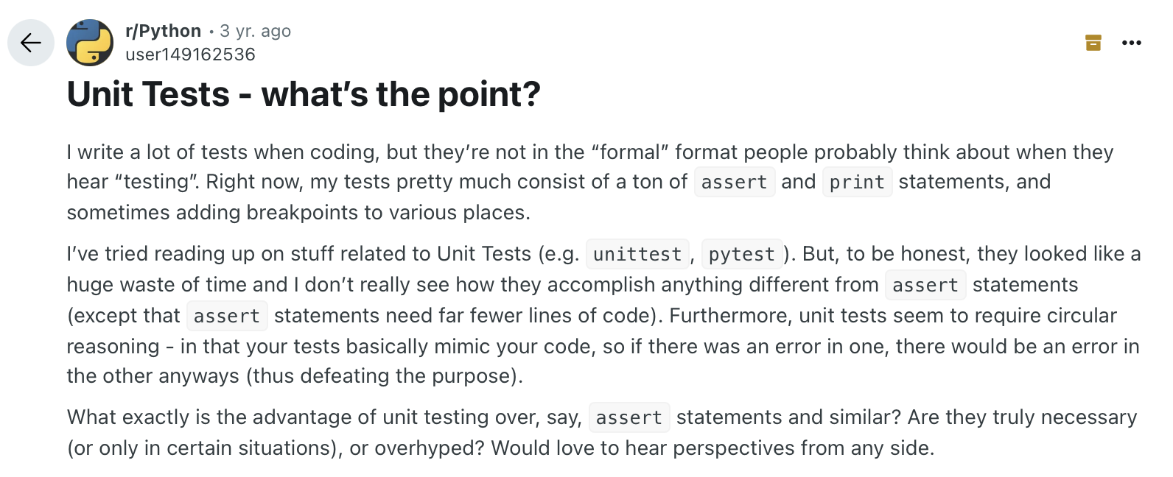
Is this really necessary?
https://www.reddit.com/r/Python/comments/voc6kr/unit_tests_whats_the_point/

Slide 26
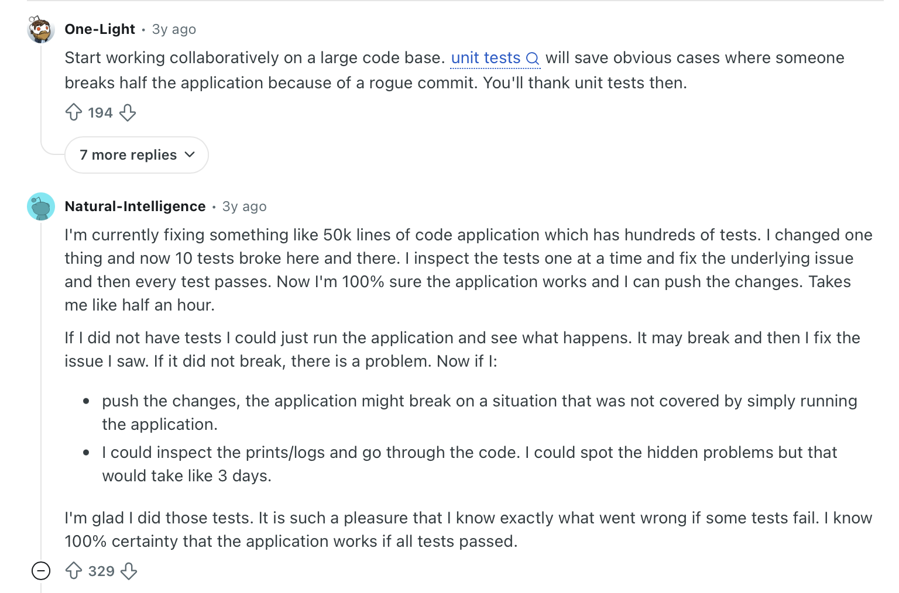
Is this really necessary?

